Slide 1
Commercial Lending
Bill Carmack
Account Executive
516-692-0340
wcarmack@axosbank.com

Slide 2
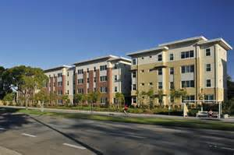
Income Property Lending
Commercial/Industrial Property Types
Retail Centers
Office Buildings
Industrial
Self Storage
Mixed Use
Up to 45% of the gross rents and total square footage coming from the commercial component allowed
Requirements
Minimum loan amount $750k
Multi-unit properties
Investor owned
LTV to 70%
Major MSAs

Slide 3
Income Property Lending
Multifamily Loan Sizing
Determine Eligibility
Location
Tier 1, 2, or 3
Loan to Value
Function of the Gross operating income
Gross Rent Multiplier
Debt coverage ratio
Maximum loan amount based upon Net Operating Income

Slide 4
Income Property Lending
Project/Pricing Tiers
Tier 1
Designed for high quality, stabilized and seasoned properties
Located in major metropolitan areas
Newer construction <20 years
Well Maintained property with no deferred maintenance
Rent > $1.75/sq ft. Value per unit > $200,000
Tier 2
Average quality and appeal
Located in major metropolitan areas
Average location
Older projects with minor deferred maintenance
Rent > $1.25/sq ft. Value per unit > $150,000
Tier 3
Lower quality property within a major urban market
Small to medium sized markets
Rent < $1.25/sq ft. Value per unit < $150,000

Slide 5
Income Property Lending
Maximum Loan Amount: Property Income
Debt Coverage Ratio- Generally 1.25 NOI to $1.00 debt
Example
Gross Income (Scheduled Rents) $100,000
Expenses (subtract)
Insurance $5,000
Taxes $10,000
Maintenance $5,000
Utilities $15,000
Management $5,000
NOI $60,000 (divided by 1.25=max $ pmt amount)
$60,000 / 1.25 = $48,000 / 12= $4,000
$4,000 @ 5% amortized over 360 months = $745,000 Max loan amount

Slide 6
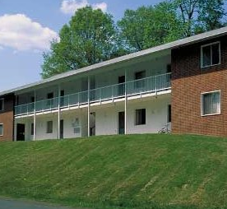
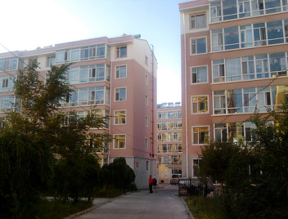
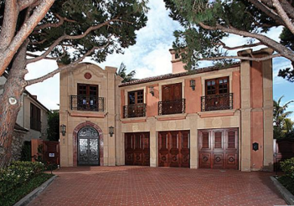
Income Property Lending
Multifamily Valuation
Gross Rent Multiplier value divided by Annual Gross Rents
Lower End
Will likely be a GRM of 4,5, or 6
Medium
7,8, perhaps 9
Upper End Properties
10, 11, + Well Maintained

Slide 7
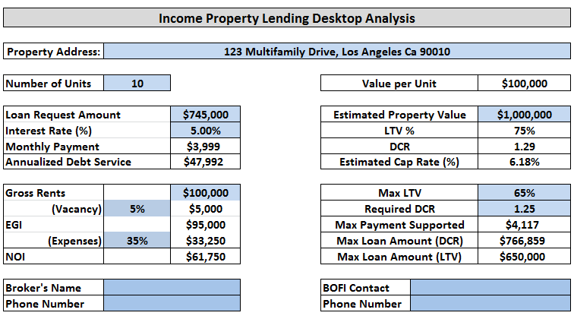
Income Property Lending
Loan Sizing Tool

Slide 8
Income Property Lending
Multifamily Process
Information required for LOI
Operating statements past 2 years & YTD
Rent Roll
Statement of Net Worth
- Liquidity
- Recurring income
Purchase contract (if applicable)
Property photos
Property profile
Signed LOI is returned
Check is returned with the executed LOI
Borrower credit package is completed
Appraisal is ordered
Site inspection is ordered
Title is ordered
Environmental ordered if required
Underwriting completed & needs list issued
Closing Process
Final underwriting items received and cleared
Appraisal received, reviewed, and accepted
Loan Documents are prepared and sent to closing agent
Axos funds rebate with proceeds wire direct to originator
Rebate not required to be disclosed
Originator must deliver a demand to closing agent for points charged to borrower

Slide 9
Income Property Lending
Typically 60 day start to COE
Appraisals more complex and more costly
Site inspections are required in addition to appraisal
Seller must submit demand to escrow to receive upfront origination fees
Qualification Debt Coverage Ratio vs. Debt To Income & credit
Multifamily loans are more expensive - $3500 appraisal & $2700 processing fee
All Income property loans carry prepayment penalties
Property qualifies over borrower
Multifamily vs. Residential

Slide 10
Small Balance Commercial
Small Balance Commercial
Eligible Property
Multi-tenant Property
5 Unit Investor Owned Strip mall
Mini-Storage
Major MSA High Traffic Location
Single Tenant Case by Case
Ineligible Tenant
Marijuana Dispensary
Massage Parlors
Smoke Shops

Slide 11
Income Property Lending
Nationwide Lending Platform
Yield Spread Premium Pricing
Tier 1, 2, and 3 Properties Considered
Borrower credit and income flexibility
Technology based loan delivery
Internal support manages transaction process
Foreign national borrowers allowed
Portfolio lending
Aggressive pricing and prepayment penalty
Advantages of Axos Bank

Slide 12
TPO Wholesale and Correspondent: Seller Success Package
How can Axos help me succeed?
Branded Marketing
Axos has a robust marketing catalog that you can utilize when capturing business from your agents, CPAs/financial advisors or other referral sources. Email wcarmack@axosbank.com for your customized flyer.

